Slide 1
Estimating market shares of power production technologies: Discrete choice modeling
Andrew Blohm

Slide 2
Table of contents
Problem statement
Results
Discussion of the data
Theory
Methods

Slide 3
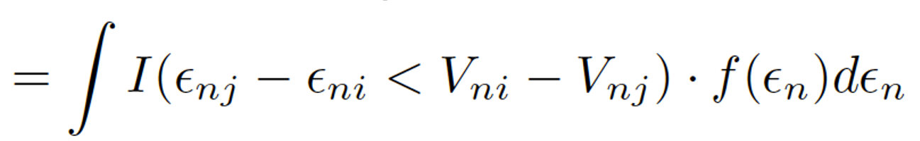
Problem statement
In the electricity sector of GCAM the logit parameters for the discrete choice model (i.e., choice between primary fuels and production technologies) are not based on historical data, instead they represent a best guess.
The specification of the error (i.e., f(epsilon_n)) is what differentiates one discrete choice model from another.
The current GCAM specification uses the Weibull distribution, while multinomial logits typically use the extreme value distribution (we end up using the Generalized Extreme Value distribution).
For this reason, we cannot directly compare the raw output of our model and the GCAM logit parameters. However, Robert using a Taylor series expansion found that if we divide the logit exponents used in the GCAM model by the fuel cost (we use the natural gas fuel cost) then we can compare the results of our analysis with the GCAM logit exponents.
P_{ni}

Slide 4
Results: Comparing the GCAM logit exponent to the multinomial logistic regression
Fuel choice (i.e., nest) | GCAM logit exponent over cost
Coal | -1.61
Natural gas | -1.94
Oil | -1.09
Solar | -0.29
Geothermal | -0.74
Wind | -1.09
Model logit exponent
-1.96
We can see that the current GCAM logit exponent parameterization is supported by the historical data.

Slide 5
Data
Overnight cost – EIA Annual energy outlooks
Fixed and variable maintenance costs – EIA Annual energy outlooks
Installed capacity – EIA Form 860
Heat rate – a variety of sources
Fuel cost – Electric Power monthly
Capacity factor – EIA Form 923 and EIA Form 860
More information on the data used and the data cleaning process can be found in the andymd26/fuzzy-waffle github repository

Slide 6
Data: Overnight cost (AEO)
The overnight cost is the cost of a construction project with no interest incurred.
Overnight cost data is available beginning in 1997 and is published every year. The categories of production technologies in each year has changed somewhat as old technologies are retired and new technologies emerge.
We use the overnight cost data from the supplemental materials found in each Annual energy outlook.
Each outlook estimates the characteristics of new generation units including operational characteristics and cost assumptions.
Each year the AEO estimates project lead time, average size, heat rate, fixed and variable operation and maintenance costs, and overnight costs for a suite of first and nth of its kind power production technologies.
Unfortunately, these categories do not match up well with the categories found in EIA form 860.

Slide 7
Data: Fixed and variable maintenance costs (AEO)
From the AEO supplemental material we also select the fixed and variable operations and maintenance costs for each technology.
Fixed operations and maintenance costs are expenses that don’t vary with production (i.e., routine preventive and predictive maintenance, general and administrative expenses, etc.)
Variable operation and maintenance costs are expenses that vary with production such as water, disposal expenses, power purchases, etc.

Slide 8
Data: Installed capacity (EIA Form 860)
Form 860 is a survey of electricity generators and is used to collect generator level data on existing and planned power plants with an installed capacity greater than 1 MW.
The dataset includes capacity, installation date, operating status, primary fuel, and technology at the generator, plant and utility level.
However, the technology categories in Form 860 do not readily map onto the overnight cost, technology categories. Thus, it requires mapping the available generator type in the overnight cost database to the installed capacity by generator in Form 860. We discuss these methods in our supplemental material.
Form 860 has 37 prime movers and 78 primary fuels, which form 190 unique, pair-wise combinations in the database, whereas the overnight cost database contains between 15 and 20 cost categories with the exact number fluctuating year-to-year.

Slide 9
Data: Heat rate (various data sources)
The marginal cost of producing power not only depends on the price of fuel but also on the efficiency of the production process. The heat rate is a commonly used measure to assess the efficiency of a power plant in turning fuel into electricity.
Form 860 has generator level heat rate data for the period 1990 to 1995.
Draw diagram of levels of data in Form 860 [generator, plant, utility]
In July of 2007 the California Energy Commission adopted the Quarterly Fuel and Energy Report (QFER) requirement, which provided for the collection of information concerning electricity generation. The energy almanac contains plant level heat rate data for the period 2007 to present for all generators located in the state (Form 860 has data one level lower (i.e., the generator), whereas QFER is an average of the generators for a plant). Data in California actually begins much earlier in 2001.
We use a simple linear regression model to identify any trends in heat rate for each AEO category and project it forward. We also include the theoretical efficiency limit for each technology in the regression, which prevents the model from projecting impossible efficiencies for immature technologies.

Slide 10
Data: Fuel cost
Fuel cost data are published in the Electric Power monthly report, which publishes the electric utility receipts and average cost for fossil fuels used in the power generation sector.
We adjust the fuel price for the efficiency of each production technology using the heat rate of the technology (i.e., new variable is the amount of fuel required to produce 1 MWh of electricity production).

Slide 11
Capacity factor (Form EIA-923)
We calculate the capacity factor for each prime mover, primary fuel pairing using EIA Form 923.
EIA Form 923 surveys approximately 4,100 power plants each year and contains plant level data (i.e., one level above the generator) on technology choice, environmental compliance, net generation, etc.
We use the annual net generation found in Form 923 and the size found in EIA Form 860 to calculate the capacity factor, which necessarily introduces some error into our calculations (the two data sources do not agree on the number of generators at each site).
The advantage of this approach is that the capacity factors are tailored to our categories.

Slide 12

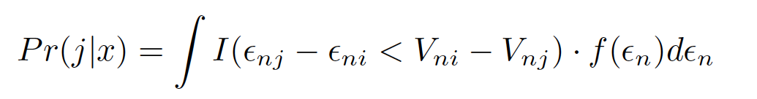
Theory: Discrete Choice Models
An agent n faces a choice of technology alternatives J, j = 1, …, J
We assume that each agent is attempting to maximize their own utility U_{ni} through the selection of a technology alternative. Each agent chooses a technology if and only if
U_{ni} > U_{nj} i neq j
We can’t observe U_{ni}, instead we can observe information about the choice set x_{ni} for all J, as well as the agent s_{n} for all n
Using this information we can specify a utility function for each agent
U_{ni} = V_{ni} + epsilon_{ni}
V_{ni} = V(x_{ni}, s_{n})
The probability that the agent n chooses technology i is
Pr(U_{ni} > U_{nj} for all i not equal to j)
Pr(epsilon_{nj} – epsilon_{ni} < V_{ni} – V_{nj} for all i not equal to j)
The probability that agent n chooses technology i is the probability that the difference in error terms is less than the difference in observed utility. We can rewrite this as the following, where I() is an indicator function in the event that the statement in the parenthesis is true and zero otherwise
a
The specification of the density (f(epsilon_n)) is what differentiates one discrete choice model from another.

Slide 13
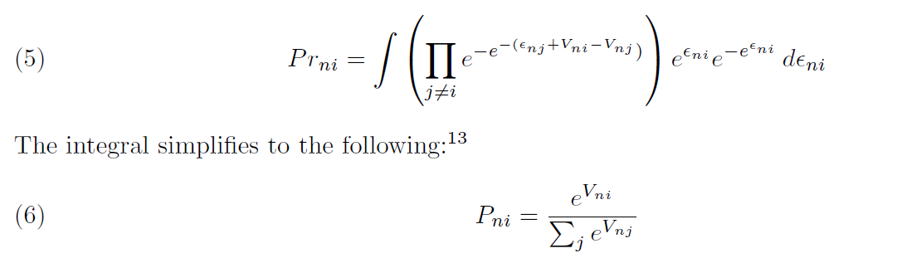
Model: multinomial logit
Logit parameterization makes the assumption that the unobserved portion of the density (f(epsilon_n)) is distributed iid extreme value for all i, which means that Pr_{ni} can be written as:

Slide 14
Model: Cont’d
The multinomial logit model assumes that
The IIA assumption holds (i.e., unobserved portion of the utility is uncorrelated over the choice set and have the same variance)
Another way to think about this is to consider the ratio of two alternatives, which should only depend on the characteristics of each alternative and not be related to other alternatives
We could think of several reasons why this assumption might be violated in the electricity sector
Using the Hausman consistency test we reject the null hypothesis of IIA and thus, we should estimate the model with a structure that accounts for the violation of the IIA assumption.
The Hausman test checks that the probability ratio between each pair of choice alternatives is only determined by the characteristics of the alternative.

Slide 15
Model: Nested multinomial logit
To address the violation of the IIA assumption we estimate a nested multinomial model using the same nesting structure found in GCAM.
The nests in GCAM are natural gas, coal, biomass, nuclear, refined liquids, solar, wind, and geothermal
Production technologies in our analysis (presently) include
coal – steam turbine
natural gas – combined cycle and combustion turbine
Oil – combined cycle and combustion turbine
Solar – photovoltaic and solar thermal
Wind – onshore
Geothermal

Slide 16
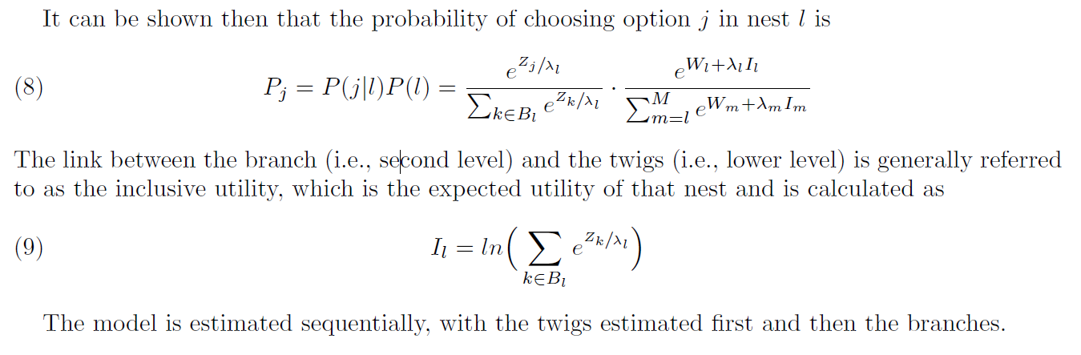
Model: Nested multinomial logit
The nested logit model assumes that the error terms are distributed generalized extreme value (GEV), which allows for correlation among alternatives located in the same nest (1-lambda is a measure of correlation).

Slide 17
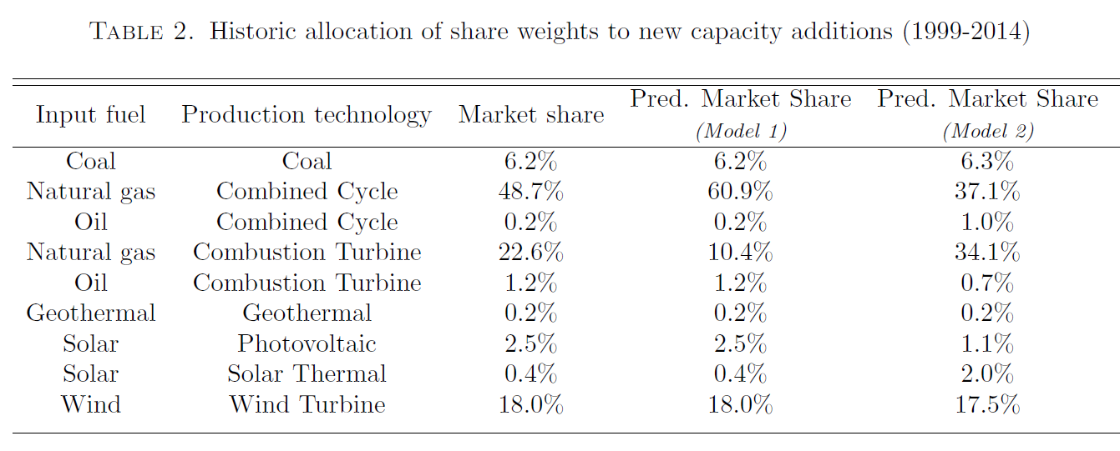
Results

Slide 18
Discussion
The model offers some support for the logit parametrization currently found in GCAM
Future work could include a probit expansion, more historical data, more nests in the data for missing fuel types, …

